Slide 1
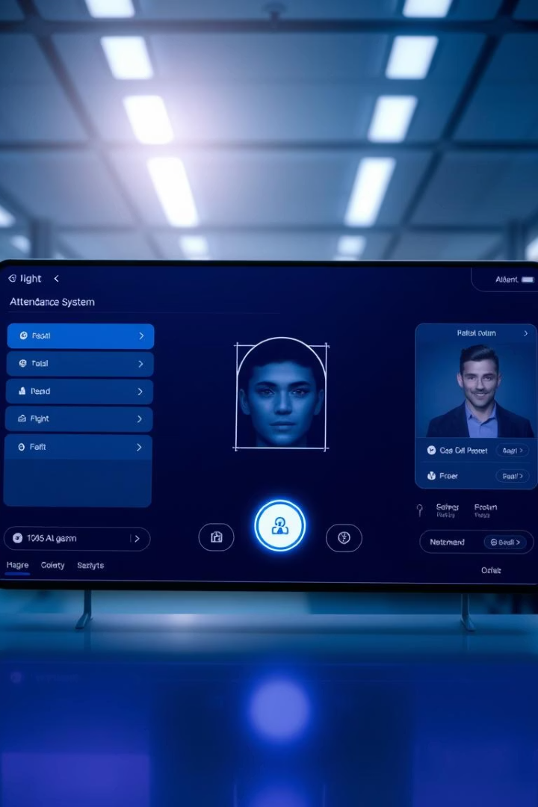
Smart Attendance System with Face Recognition
Presented by:
Minhaj Asghar
Malaika Jahangir
Mahak Farhan
Ahmed Javaid
Arsalan Aftab

Slide 2
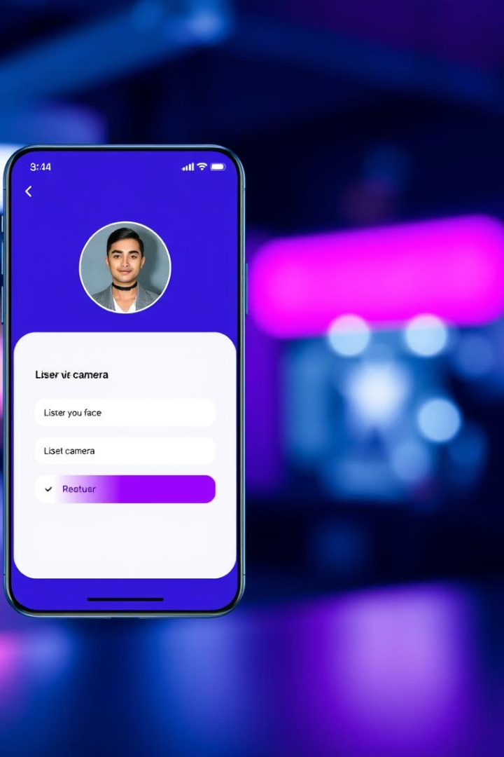
Project Introduction
Purpose
Functionality
Web app built on Flask to capture and save images for attendance
Registers names and captures images automatically for attendance
Data Storage
Attendance recorded and stored in accessible CSV files

Slide 3

Tools and Technologies
Flask
Face Recognition Library
Lightweight web framework for Python
For detecting and verifying faces in images
CSV File Handling
HTML/CSS
Simple and effective attendance data storage
Creating user-friendly web interfaces

Slide 4
Project Structure
Backend
Frontend
Data Storage
Supporting Scripts
Flask app routes and face recognition logic
HTML templates and CSS for user interface
CSV files for attendance and folders for saved images
Modules for image capture and processing workflows

Slide 5
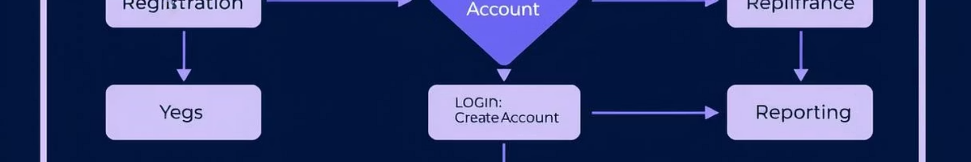


Workflow
User Registration
User enters name
Images captured automatically
Confirmation message shown
Marking Attendance
Attendance process triggered
Images processed and logged
Success message displayed

Slide 6
User Interface
Name Input
Submit Button
Flash Messages
Field for users to enter their name
Registers the user in the system
Displays success or error notifications

Slide 7
Challenges and Results
Results
Challenges
Accurate registration of users
Ensuring image accuracy and quality
Attendance saved in CSV successfully
Validating user input properly
Users get timely feedback
Managing image and data storage efficiently

Slide 8

Conclusion
Project Success
Effective web-based attendance system using Flask and face recognition
User-Friendly Design
Simple interfaces and smooth workflows
Future Enhancements
Improve accuracy and add user authentication for security

